Slide 1



Introduction to Amazon Sales Analytics
Welcome to the world of Amazon Sales Analytics! This presentation will guide you through the intricate landscape of analyzing the Amazon sales data, empowering to make data-driven decisions that boost your revenue and propel your brand to success.

Slide 2
Understanding Amazon's Marketplace
Vast Ecosystem
Customer-Centric Approach
Data-Driven Insights
The Amazon marketplace is a complex and dynamic environment with millions of sellers competing for customer attention. This immense competition underscores the importance of understanding the marketplace dynamics, including customer behavior, product trends, and search engine optimization (SEO) strategies.
Amazon prioritizes a customer-centric approach, placing significant emphasis on customer satisfaction and a seamless shopping experience. Sellers must align with this philosophy, focusing on product quality, prompt delivery, and excellent customer service.
Amazon provides a wealth of data and analytics tools for sellers. Leveraging this data is crucial for understanding your customer base, product performance, and market trends. By analyzing your sales data, you can make informed decisions to optimize your strategies and improve your overall business.

Slide 3
Data Cleaning and Preparation
1
Data Pre-processing
2
Dimensionality Reduction
Ensured data consistency by standardizing formats (e.g., date and time formats, currency).
Unnecessary Feature Removal: Removed redundant, or low-variance features to simplify dataset and improve model efficiency.
Addressed missing values by using imputation techniques or removing rows/columns with excessive missing data.
Feature Selection and Extraction: Used techniques like PCA and correlation analysis to retain significant features, preserving essential information and enhancing analysis robustness.
Normalized and scaled numerical features to bring them onto a common scale.
3
Outlier Detection and Removal:
4
Exploratory Data Analysis (EDA)
Identified outliers using statistical methods (e.g., Z-score, IQR).
Conducted EDA to understand the underlying patterns and relationships in the data.
Removed or transformed outliers to prevent them from skewing the analysis results.
Utilized visualizations such as histograms, scatter plots, and box plots to identify trends and anomalies.

Slide 4

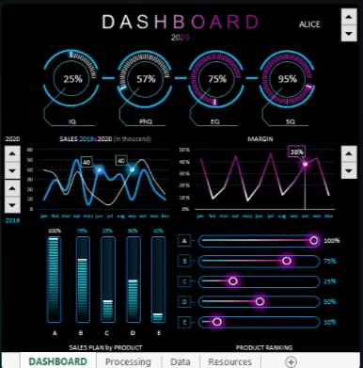
Main KPIs
Total Revenue
Countrywise Profit
This metric represents the overall income generated from your Amazon sales, providing a clear picture of your business's financial health.
It measures the net profit generated from sales in each country, helping Amazon identify profitable markets, and strategize for targeted growth and investment.
Profit Margin
Revenue Over Different Regions
This metric measures the percentage of revenue that exceeds the costs of goods sold, indicating the profitability of products and the effectiveness of pricing strategies.
These metrics reflect customer satisfaction with your products and services, influencing brand reputation and future sales

Slide 5
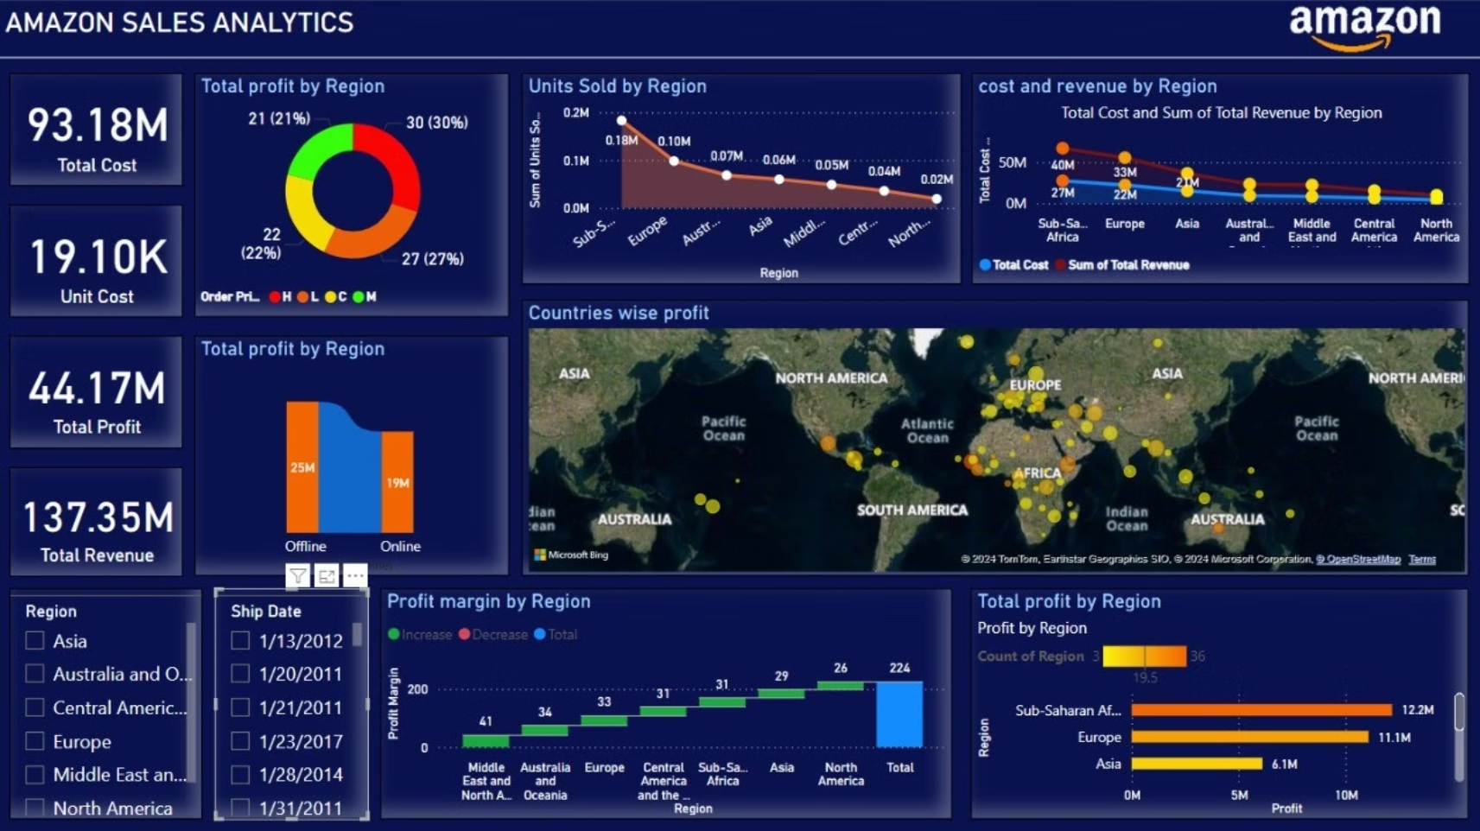
Dashboard

Slide 6
Tracking Sales Performance
1
2
3
4
Sales Reports
Performance Indicators
Data Visualization
Regular Analysis
Amazon provides detailed sales reports, allowing you to track your sales history, product performance, and customer demographics.
Utilize data visualization tools to create graphs, charts, and dashboards that provide a clear and concise picture of your sales performance. This allows you to identify patterns, trends, and areas for improvement.
Conduct regular analysis of your sales data to identify strengths, weaknesses, and opportunities for optimization. This iterative process helps you continuously improve your sales strategies.
Monitor key performance indicators (KPIs) like total revenue, average order value, conversion rate, and customer reviews to gain a comprehensive understanding of your sales trends.

Slide 7
Recommended Strategies for Growth and Profitability
Expand Product Portfolio
Improve Customer Experience
Introduce new products within your existing category or explore expanding into related categories to diversify your offerings and reach a wider audience.
Focus on providing exceptional customer service, fast shipping, and hassle-free returns to build trust and loyalty, leading to repeat purchases and positive reviews.
Leverage Amazon Advertising
Optimize for Mobile
Invest in Amazon's advertising platform to increase your product's visibility, drive targeted traffic, and boost sales. Experiment with different advertising campaigns to maximize your return on investment.
Ensure your product listings are optimized for mobile devices, as a significant portion of Amazon's traffic comes from mobile users.

Slide 8
Thank You
We appreciate you taking the time to explore the power of Amazon sales analytics. This presentation has provided a comprehensive overview of the insights and strategies to drive your business growth on the Amazon marketplace.

